Slide 1
K-12 Pooled Classroom Testing CDPH program overview

Slide 2
We all share one goal: full, in-person learning. Testing helps us get students back to school safely and successfully.
1
California Department of Public Health and Concentric by Ginkgo are partnering to bring free pooled testing to schools statewide.
2
Pooled testing offers regular COVID monitoring and targeted intervention when needed, per CDC guidance.
3
CDPH’s pooled testing program is an end-to-end testing solution, including staffing support, school-friendly protocols, training, customer support, and a digital platform for tracking results.
Notes:
https://www.cdph.ca.gov/Programs/CID/DCDC/Pages/COVID-19/K-12-Guidance-2021-22-School-Year.aspx
Why classroom pooled testing
How does pooling work?
CA’s integrated testing program
What happens with positive pools
School and community support materials

Slide 3
Why classroom pooled testing?

Slide 4
Affordable
All-inclusive, free testing and on-site support staff available to test students statewide.
Simple
Self-swab process for kids as young as kindergarten. Test an entire classroom in less than 15 minutes a week, with an easy online portal to get results.
Peace of Mind
Confidence for your school community
Empowering
Kids and school communities feel that they are part of the solution.
Key benefits of classroom pooling: simplifies logistics, reduces costs, and enables schools to make informed decisions.

Slide 5
“
Having a negative test is a morale booster. People walk taller and feel more secure. [...] It lifted the fear.”
Testing instills confidence in your school community as students and staff return to in-person learning.
Teachers, administrators, students, and families feel safer and more reassured with routine testing.
— MA School Superintendent
“
Most of our families were really excited [...] They welcomed it. It made them feel safer which is the ultimate goal.”
— Baltimore School Principal
“
“
Just to stay on top of the cases, know what's going on, and then have a plan when things do go wrong is the only way to keep going”
82% of Wellesley Public Schools staff were reassured in the safety of returning to school following the results of baseline testing.”
— Milwaukee Public Schools Parent
— WPS Survey Results

Slide 6
How pooling works

Slide 7
STEP 1
Self Swab
25 students (and teachers!) in a class self-swab and drop their swabs into a single tube.
The Foundation is Classroom Pooled Testing with “every student, every week” reach
All students and teachers swab their noses with short swabs (think: cotton swabs) in the classroom. Every swab is dropped into one tube (this is the “pooling” step). This pool is then run as a single test.
Only positive pools result in further action. For a positive classroom result, next steps are decided by the school and will look a little different based on a school’s unique circumstances.
STEP 2
Test the Pool
That tube is then run using one test, and the classroom is provided with one result.
STEP 3
Get Results
Only positive pools result in next steps, which vary by school.
POOL #0001
Test Result:
Negative

Slide 8
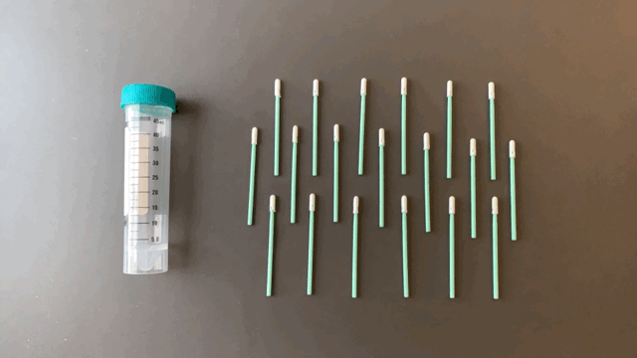
What does Pooled Testing look like?
Component 1
Pooled Testing
Pooled testing is the foundation of Concentric’s program. This approach is designed to minimize the burden on school staff and allows 5-25 individuals to be tested as a group.

Slide 9
SCHOOL HIGHLIGHT Collins Middle School, MA
Pooled Testing In Action

Slide 10
What happens with positive pools?

Slide 11
What Happens if There’s a Positive Pool
PARTICIPATING INDIVIDUALS
Positive Result
Individual follows protocols for isolation and quarantine following public health department guidance
FOLLOW UP TESTING
School Testing
We will administer rapid antigen tests during or after school to all students and staff in a positive pool
PARTICIPATING INDIVIDUALS
Negative - Close Contact
Individuals follow Modified Quarantine protocols, remaining in class, refraining from extracurricular activities and testing twice the following week
PARTICIPATING INDIVIDUALS
Negative - No Close Contact
Individuals with a negative result who are not identified as close contacts do not need to quarantine if they are participating in the testing program
INDIVIDUALS NOT TESTING
Close Contacts
Students who are not participating in testing will need to quarantine if they are identified as close contacts
Per CDPH Guidance: https://www.cdph.ca.gov/Programs/CID/DCDC/Pages/COVID-19/K-12-Guidance-2021-22-School-Year.aspx

Slide 12
Positive Pool Results - What We’ve Seen
~1% of pools nationwide result in a positive

Slide 13
CDPH’s integrated testing program

Slide 14
Concentric offers a fully integrated service to implement and operate a districtwide program within 10 days
Component 1
Pooled Testing
Component 2
Individual Diagnostics
Component 3
Staffing Support
Component 4
Program Admin and Reporting
Pooled testing is the foundation of the program. This approach is designed to minimize the burden on school staff and allows 5-25 individuals to be tested as a group.
Individual diagnostic rapid antigen for follow-on testing when a pool is positive.
Tier 1 - Schools use existing school resources
Tier 2 - Schools access local staffing support according to their needs
Administrative
Medical Professional
End-to-end reporting, dashboards and administration at State, District and School levels.

Slide 15
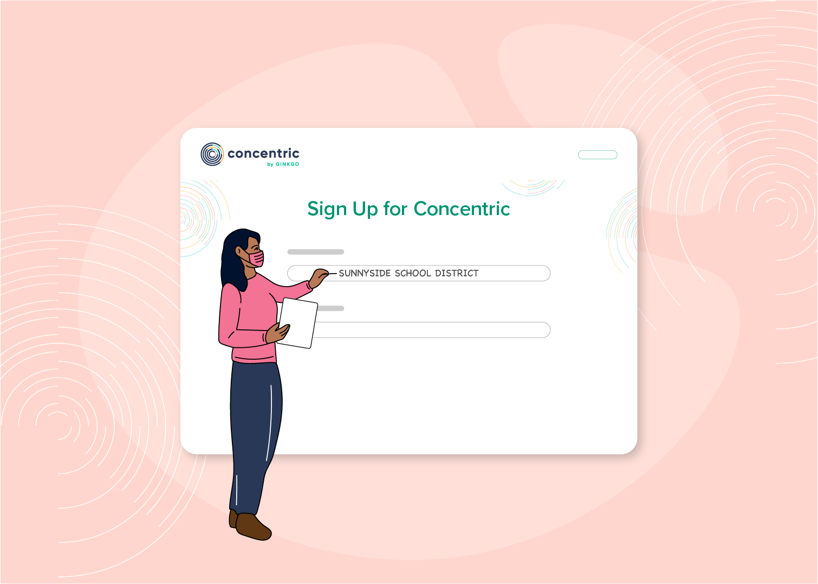
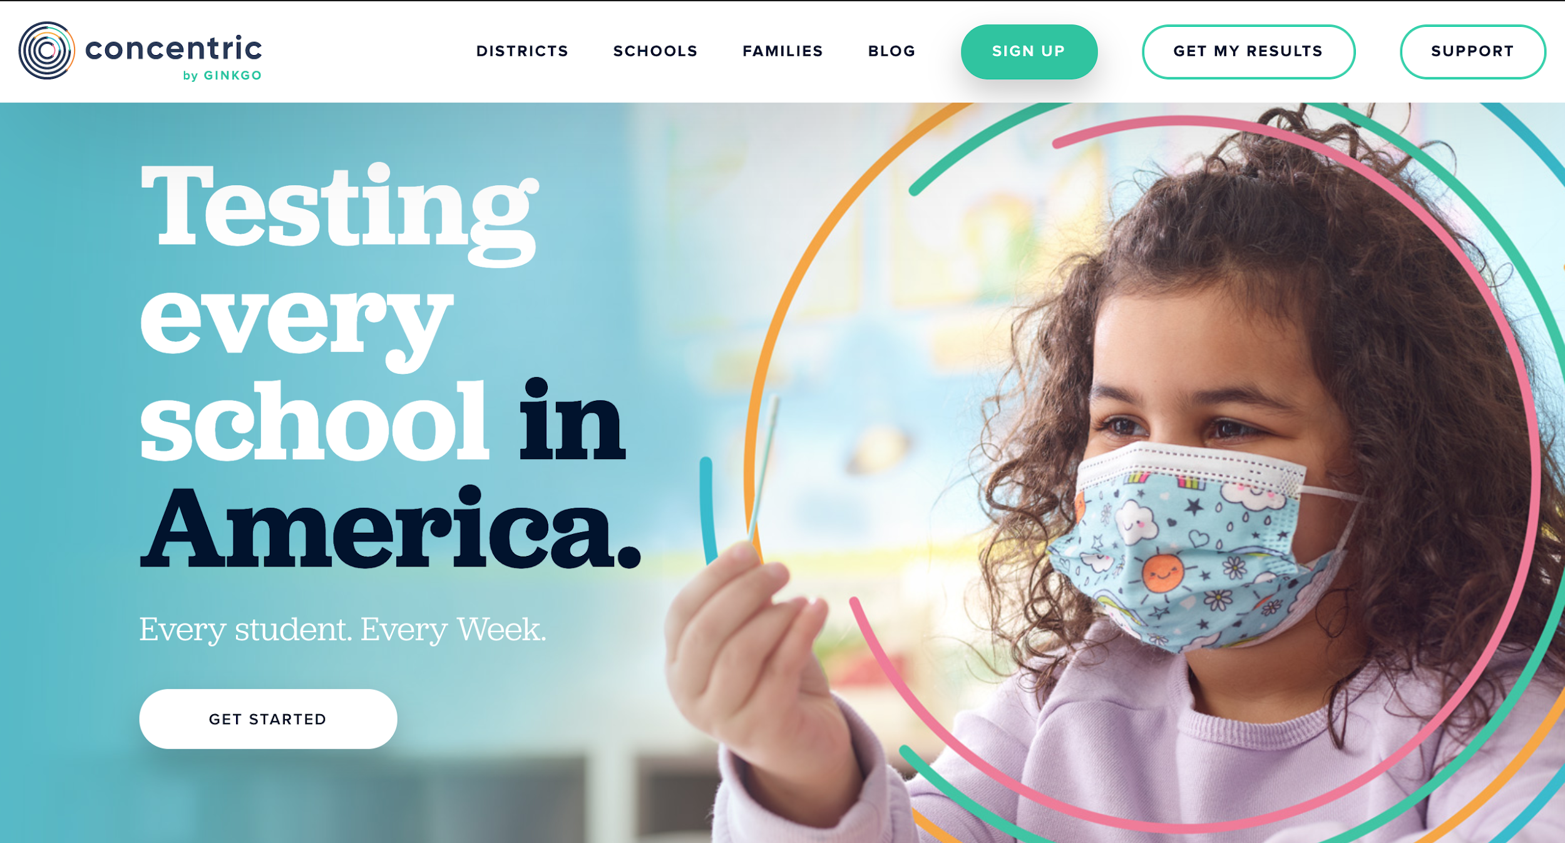
Our community engagement team supports launch at every step
1
Opt-in to the state program
2
Manage district and school onboarding and questions about the program
3
Onboard staff and teachers with our easy to use virtual training set, and/or select for further outside support through the program
4
Share consent forms, resources, and other communications with parents via our website, parent newsletters, school portal, etc.
5
Get students ready to swab with our online materials and videos

Slide 16
Thank you!
For additional information please contact:
Laura Bronner, National K12 Testing Program Lead: lbronner@ginkgobioworks.com
Jared Bombaci, State K12 Testing Program Manager: jbombaci@ginkgobioworks.com
Darci Delgado, California Department of Health: darci.delgado@dsh.ca.gov
EVERYBODY’S HEALTH IS CONNECTED

