Slide 1
Draft Maps Discussion
Presented by: Harold Freiman and Jonathan Berry-Smith, Attorneys, Lozano Smith
Questions: Shalice Tilton, Senior Consultant, National Demographics Corporation
March 3, 2022

Slide 2
Districting Process
Step | Description
Two Initial Hearings Aug. 19; Sept. 16, 2021 | Held prior to release of draft maps Education and to solicit input on the communities in the Districts
Census Data Release Summer/Fall 2021 | Census Bureau releases official 2020 Census population data – Aug. 12 California’s official ‘prisoner-adjusted’ 2020 redistricting data – Sept. 20, 27
Draft Map Hearing January 20, 2022 | Meeting to discuss 4 draft maps and the sequence of elections Board asks Demographer to create additional maps
Draft Map Hearing February 10, 2022 | Meeting to discuss 7 draft maps and the sequence of elections Board identifies Teal and Lupine maps as tentative choices moving forward
Plan Selection March 3, 2022 | Final map must be posted at least 7 days prior to adoption Opportunity for public input followed by Board selection of a map

Slide 3
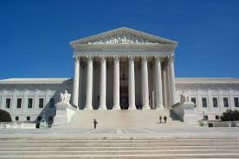
Districting Rules and Goals
Federal Laws
California Criteria
Other Traditional Redistricting Principles
Equal Population
Federal Voting Rights Act
No Racial Gerrymandering
Geographically contiguous
Undivided neighborhoods and “communities of interest” (Socio-economic geographic areas that should be kept together)
Easily identifiable boundaries
Compact (Do not bypass one group of people to get to a more distant group of people)
Respect voters’ choices / avoid head-to-head contests
Future population growth
Prohibited: “Shall not favor or discriminate against a political party.”

Slide 4
Neighborhoods/Communities of Interest
Neighborhoods
What is your neighborhood?
What are its geographic boundaries?
In the absence of public testimony, planning records and other similar documents may provide definition.
Communities of Interest
What defines your community?
Would this community benefit from being “included within a single district for purposes of its effective and fair representation”?
Communities of Interest may not include relationships with political parties, incumbents, or political candidates.

Slide 5
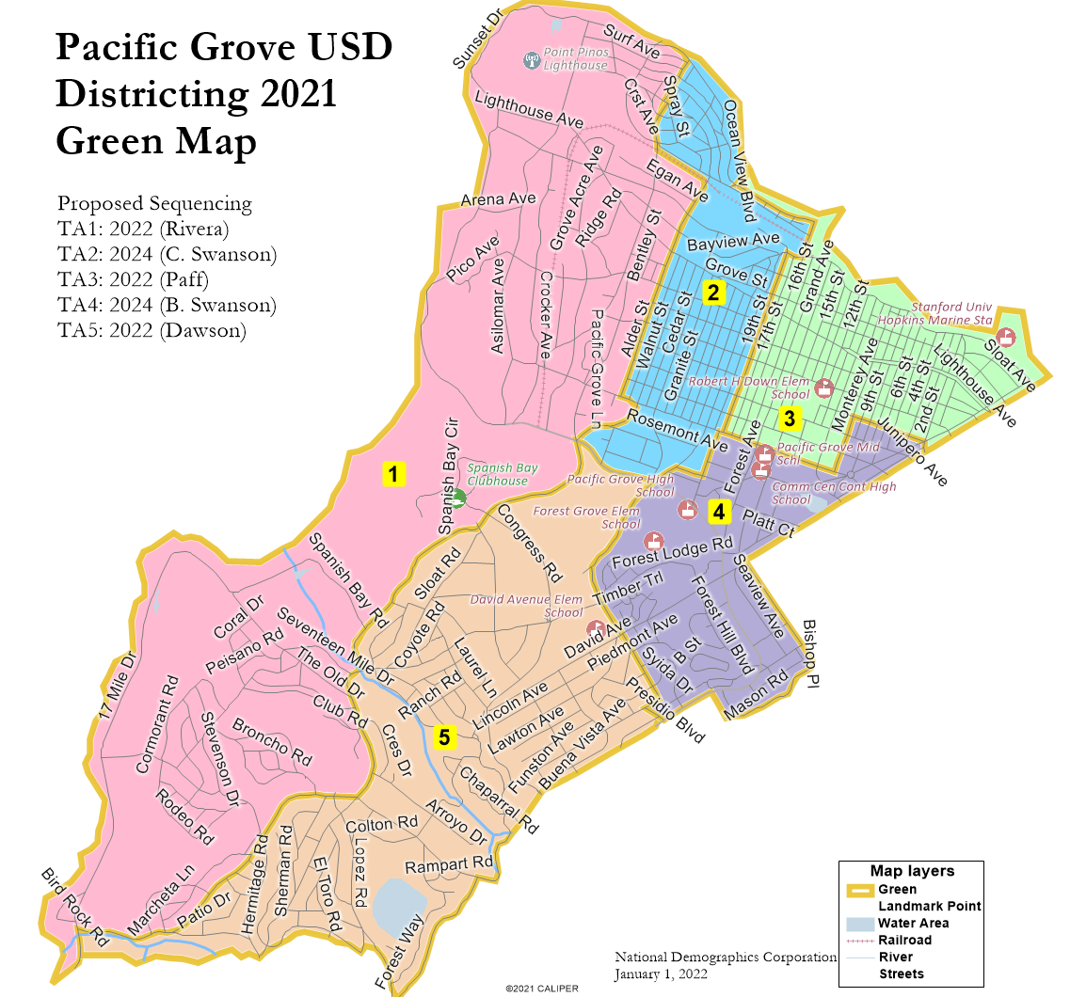
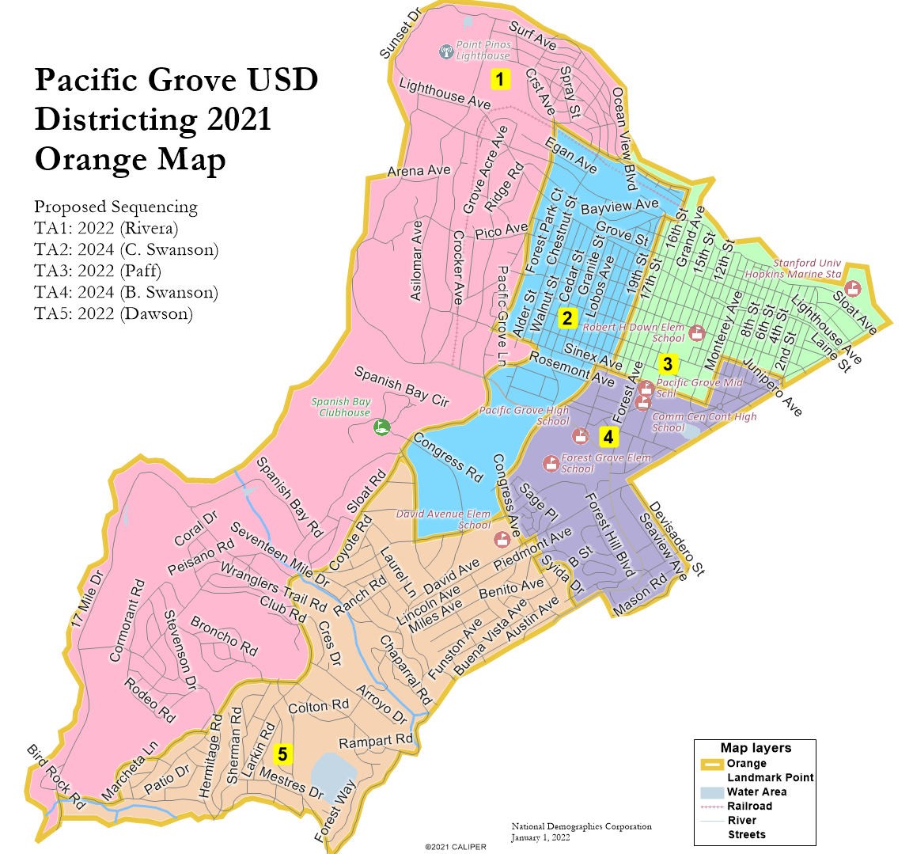
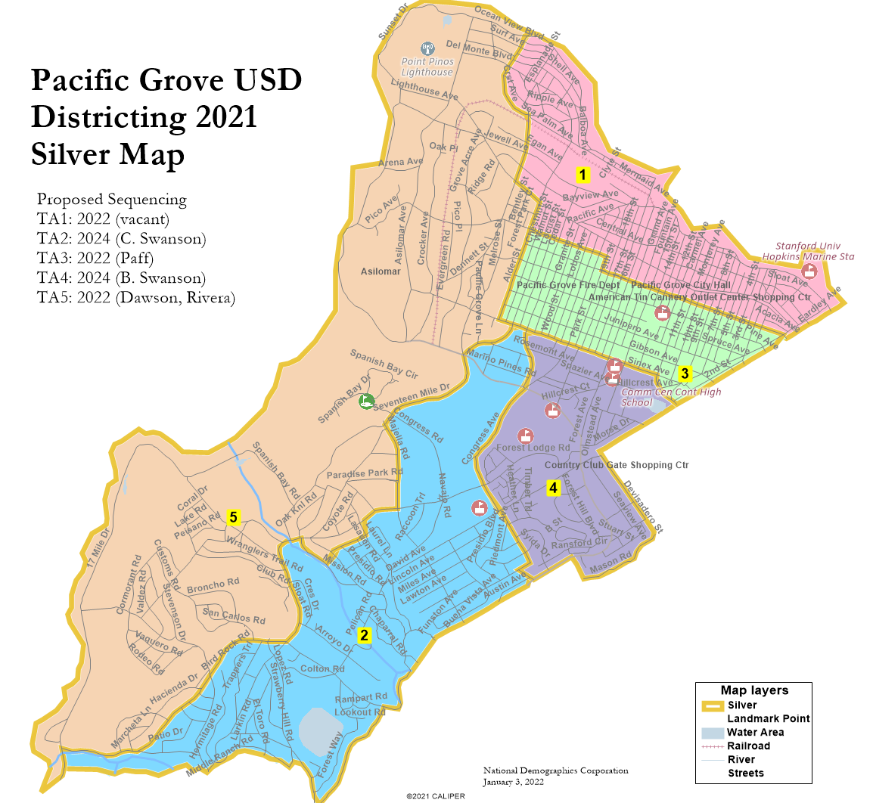
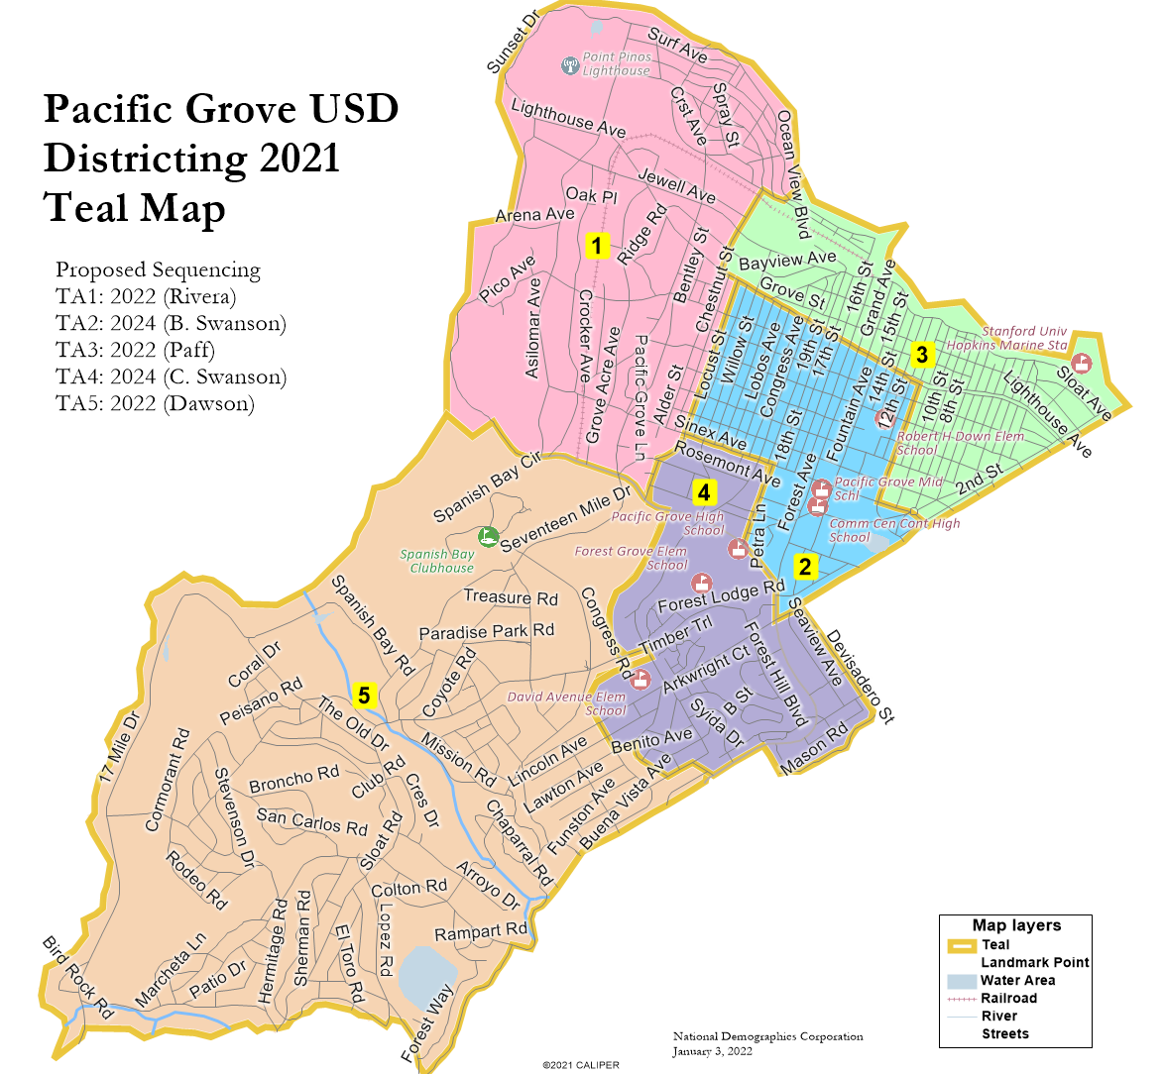
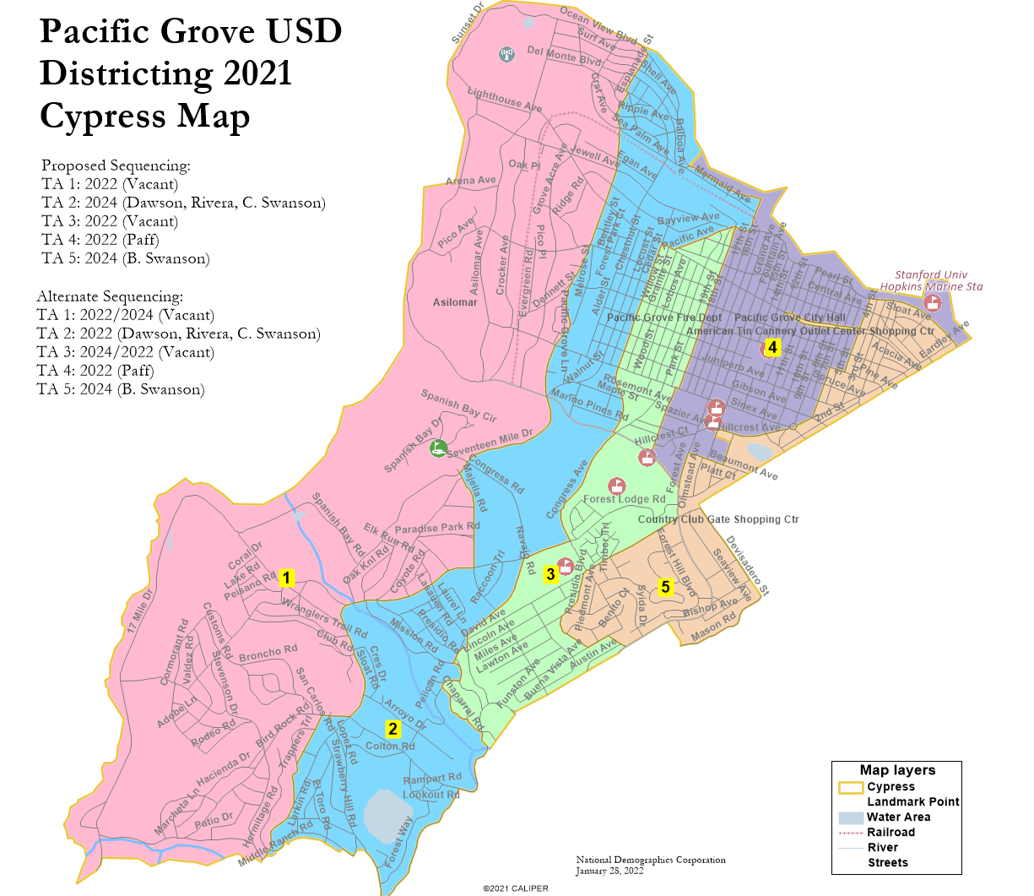
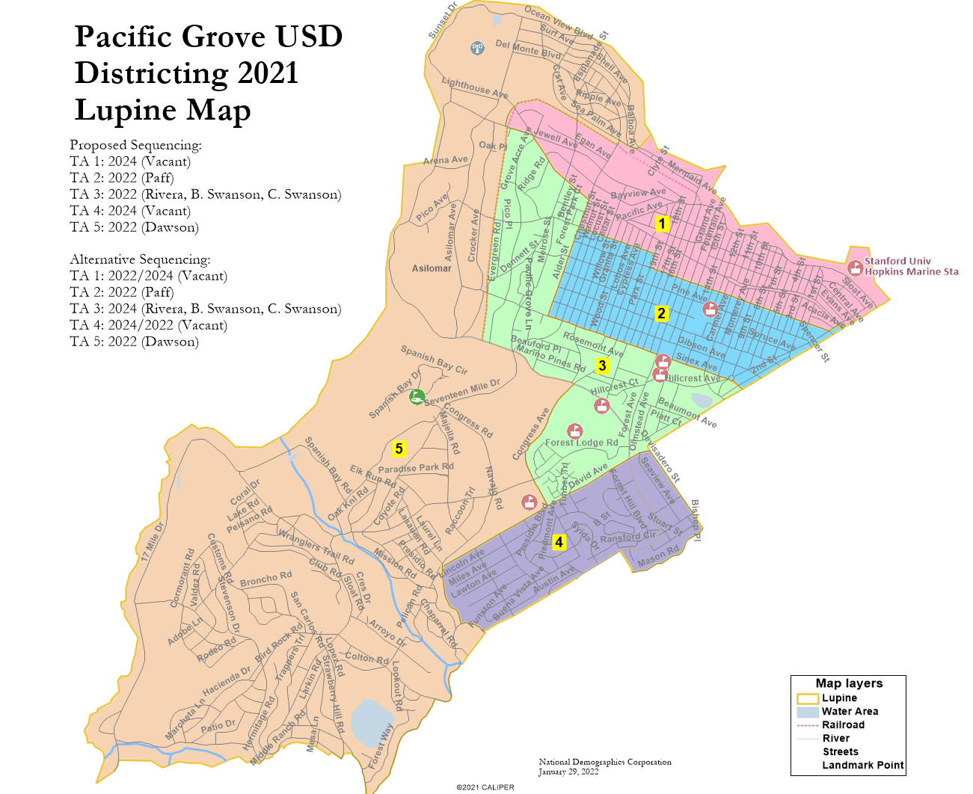
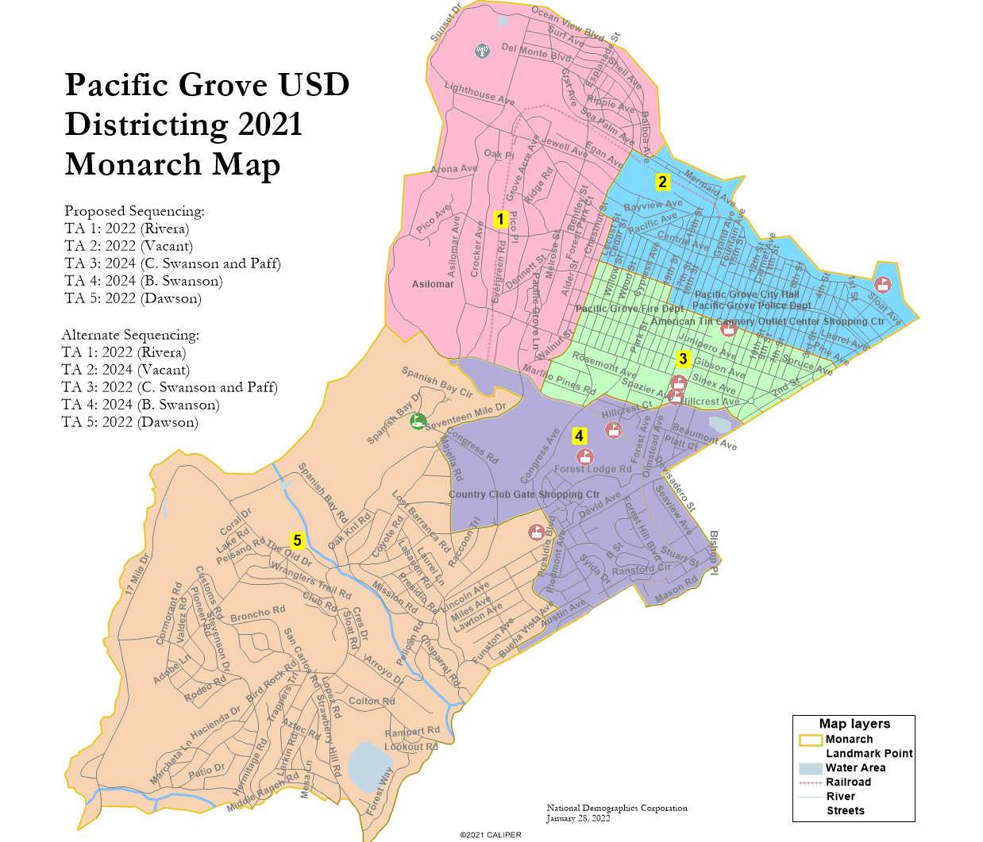
The Draft Maps

Slide 6
Board Finalist

Slide 7
Board Finalist

Slide 8
Discussion / Action

